Slide 1
Energy and the Environment-Part 2 Sustainability and Energy Efficiency

Slide 2
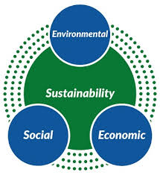
What is Sustainability?
Sustainability is the avoidance of the depletion of natural resources in order to maintain an ecological balance.
Sustainable development is meeting the needs of the present without compromising the ability of future generations to meet their own needs.
Based on three elements: environment, economy, and society.

Slide 3
Environment
Elements include:
Biodiversity
Materials
Energy
Biophysical interactions

Slide 4
Economic
Elements include:
Money and capital
Employment
Technological Growth
Investment
Market Forces

Slide 5
Societal
Elements include:
Human diversity
Equity
Quality of life
Institutional structures and organization
Political structures

Slide 6
Sustainability Problems
Depletion of finite resources
Over-use of renewable resources
Pollution
Inequity
Species Loss

Slide 7
Sustainability Solutions
Cyclical material use
Safe, reliable energy
Life-based interests

Slide 8
Energy Efficiency
The measure of the useful energy produced compared to the energy converted to low quality-usually heat.
Using energy to do work, not produce heat.

Slide 9
What is Energy Conservation?
Implementing new technology to do the same work using less energy.
Saves money, reduces pollution and CO2 emissions.
Examples:
Heating homes more efficiently
Driving more efficient cars
Lighting spaces more effeciently.

Slide 10
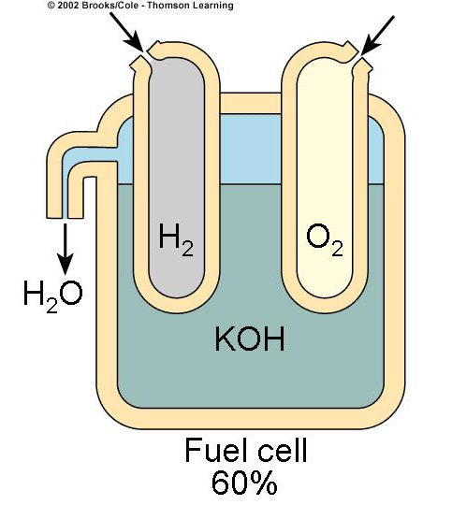
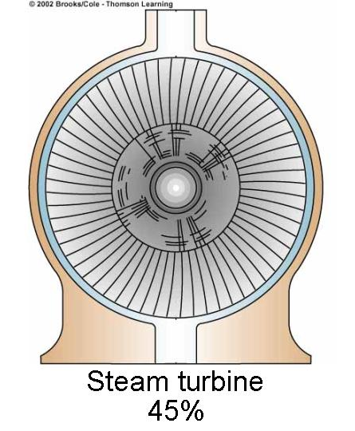
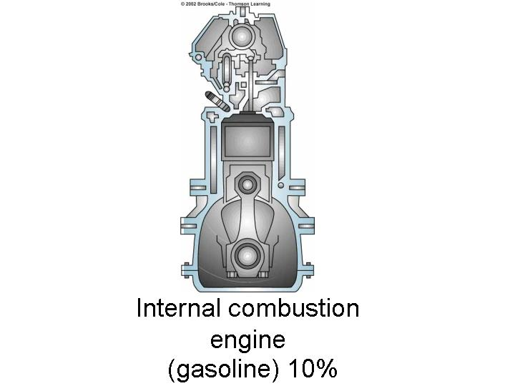
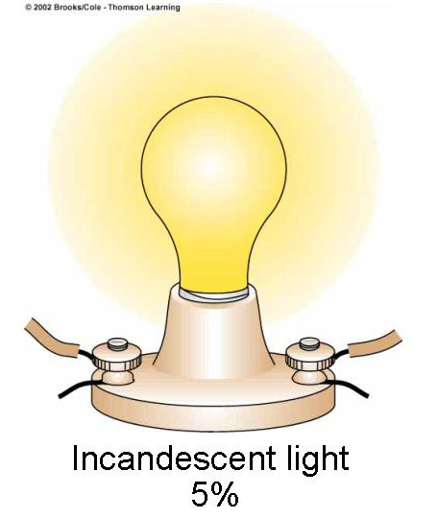
Examples:

Slide 11
The Fuel Cell-Revisited
Run on hydrogen and produce little pollution.
Combine hydrogen and oxygen to produce electricity and water vapor.
Up to 60% efficiency.

Slide 12
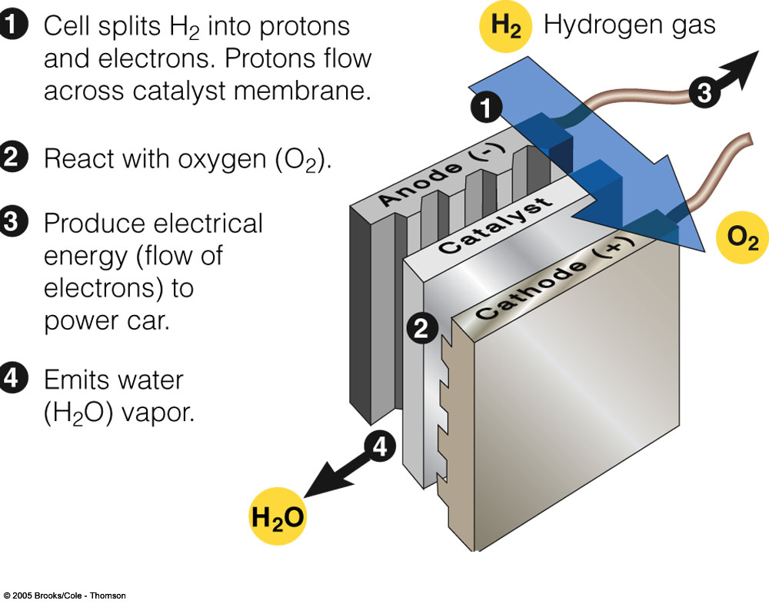

Slide 13
Green Architecture
The Sears Tower (Chicago) uses more energy in a day than a city of 150,000
Atlanta’s Georgia Power Company uses 60% less energy than other buildings its size.

Slide 14
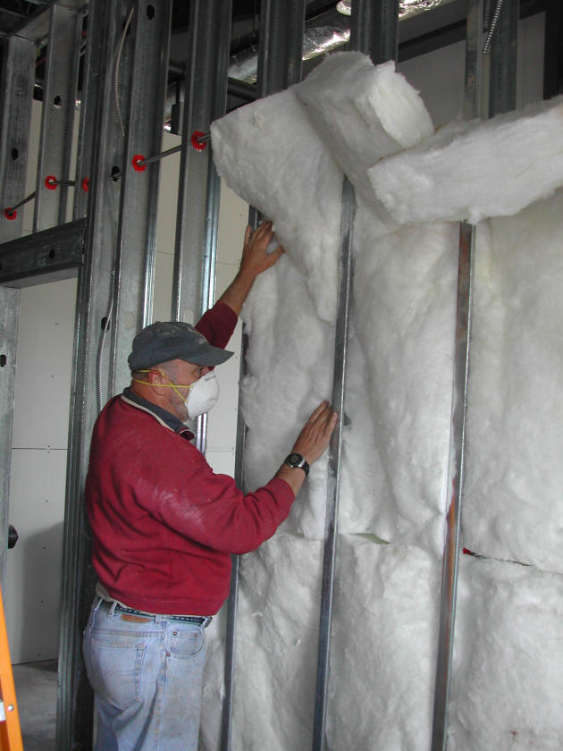
How do we build “Green”?
We can save energy in buildings by:
Getting heat from the sun
Insulating well
Using plants for shade and wind blockage

Slide 15
Examples:
Super-Insulated Houses:
Cost 5% more to build
Can use 90% less energy for heating and cooling.
Green Roofs
Plants or gardens on roofs help insulate from heat in summer and cold in winter.

Slide 16
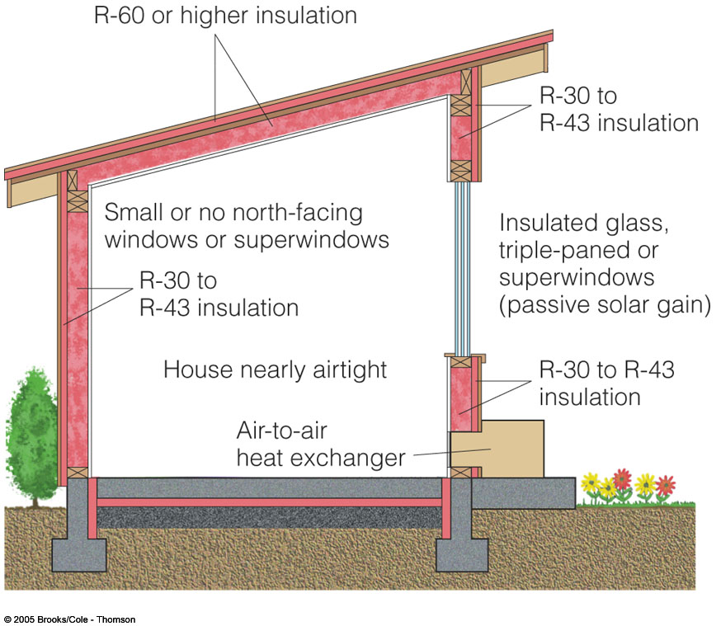

Slide 17
Saving Energy in Existing Buildings
Energy can be saved in existing buildings by:
-Insulating them
-Plugging leaks
-Using heating, electricity, cooling, appliances, and lighting more efficiently

Slide 18
