Slide 1
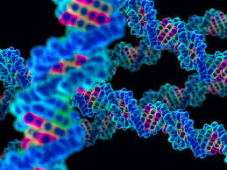
What is Genetics?
Notes 5-1

Slide 2
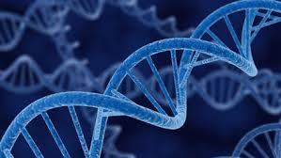
Genetics is the study of genes, heredity, and variation within an organism.

Slide 3
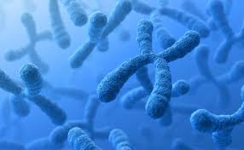
Inheritance
Generally, genes on chromosomes control an organism’s form and function.
Alleles: different forms of a trait that a gene may have.
Heredity: the passing of traits from parent to offspring.
Variation: Genetic variation is brought about by mutation, which is a permanent change in the chemical structure of a gene.

Slide 4
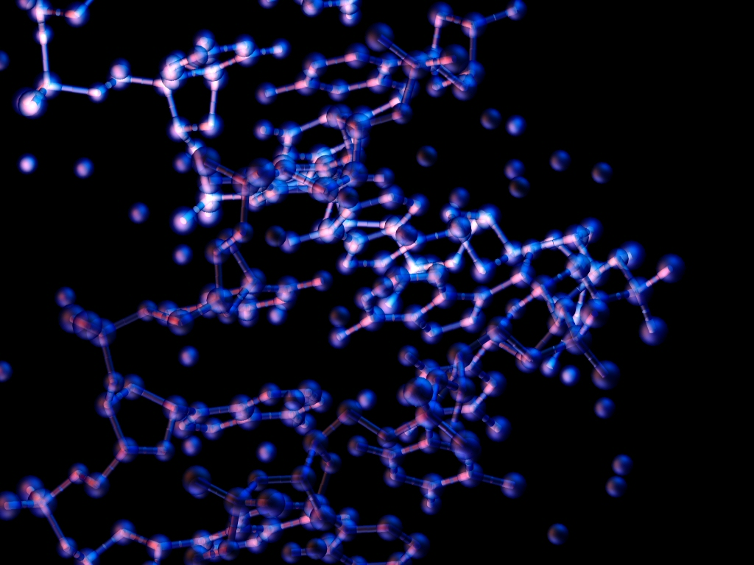
Gregor Mendel
Gregor Mendel was an Austrian monk who studied mathematics and science, but became a gardener in a monastery.
Referred to as the “father of modern genetics”.
Mendel was the first to trace one trait through several generations. He was also the first to use mathematical probability to explain heredity, by tracing the link between the color of a pea flower and the color of its seed.

Slide 5
Mendel’s Experiment
For each trait Mendel studied, he crossed two plants with different expressions of the trait and observed that new plants all looked like one of the two parents.
He cross-pollinated the plants, which is the transfer of pollen from an anther of a flower of one plant to a stigma of a flower of another plant of the same species.

Slide 6
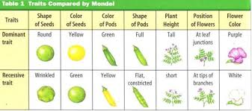
Outcomes of Mendel’s Research
Mendel was the first to trace one trait through several generations. He was also the first to use mathematical probability to explain heredity.

Slide 7
Why does this matter?
In the future, doctors and scientists hope to use our genetic information to diagnose, treat, prevent and cure many illnesses. Genes are instructions, which tell your body how to make all the proteins it needs to survive and grow. By identifying each of these proteins, scientists hope to better understand how your body works, and what is happening when it doesn't work properly. They hope this knowledge will eventually lead to more effective medicines and treatments.

Slide 8
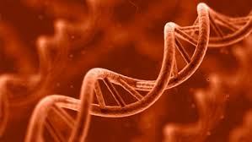
When We Return…
MONDAY:
DNA EXTRACTION LAB
I don’t recommend wearing that new Abercrombie Sweater on Monday unless you enjoy strawberry stains on it…
Bring a smile, appropriate lab attire, and CLOSED toed shoes.

