Slide 1
The Air Around You-Part 6 Carbon Footprints and Climate Change

Slide 2
Earth’s Ideal Conditions
Earth is the perfect temperature for humans to live on.
Greenhouse gases exist in the atmosphere surrounding the earth and keep it warm.
The sun gives off energy that is absorbed by earth. Some heat is radiated back into space. Gases in the atmosphere absorb some of this heat and keep the air around us warm.
This is called the greenhouse effect.

Slide 3
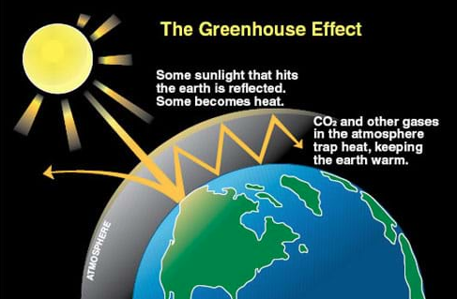

Slide 4
Greenhouse Gases
Named because they act like the roof of a greenhouse by trapping heat.
Some human activities produce greenhouse gases.
We need to maintain a delicate balance of greenhouse in the atmosphere.
Greenhouse gases include: carbon dioxide, methane, nitrous oxide, ozone, and water vapor.

Slide 5
Greenhouse Gases
Carbon Dioxide-a greenhouse gas that comes from burning fossil fuels.
Methane-a very strong greenhouse gas; a component of natural gas.
Nitrous Oxide-a very strong greenhouse gas; also causes other air pollution and regulates ozone.
Ozone-A greenhouse gas that protects humans from UV rays.
Water vapor- tiny droplets of water in the air caused by evaporation; can act as a greenhouse gas.

Slide 6
Climate Change
When levels of greenhouse gases get too high, climate change can occur.
This leads to more storms that can limit our ability to grow crops.
Scientists have created a term for the amount of extra greenhouse gases that people put in the air: a carbon footprint.

Slide 7
Carbon Footprint
Your carbon footprint is the amount of greenhouse gases emitted in the air because of your activities.
Activities such s heating your house, how you get to school, and how much you throw away can emit greenhouse gases.
Direct emissions of greenhouse gases include the tailpipe of a car or bus
Indirectly, the factory where your TV was made or at the power plant where the power for light is created emits greenhouse gases.

