Slide 1
Astronomy-Part 4 Notes:
The Life Cycle of Stars

Slide 2
Stars
A star is ball of plasma undergoing nuclear fusion.
Stars give off large amounts of energy in the form of electromagnetic radiation.

Slide 3
The Birth of a Star
Stars are formed in a nebula.
A nebula is a very large cloud of gas and dust in space.

Slide 4
Protostars
Gravity makes dense region of gas more compact.
Soon take on a definite shape and are called protostars.

Slide 5
A New Star Forms:
Once the core of a protostar reaches 10,000,000º C, nuclear fusion begins and the protostar ignites.
The protostar now becomes a star.

Slide 6
Nuclear Fusion
Nuclear Fusion is the process by which two nuclei combine to form a heavier element.
New stars initially will fuse hydrogen nuclei together to form helium.

Slide 7
Main Sequence Stars
Once the star has ignited, it becomes a main sequence star.
Main Sequence stars fuse hydrogen to form helium, releasing enormous amounts of energy.
It takes about 10 billion years to consume all the hydrogen in a Main Sequence star.
Main sequence stars are in the stable stages of their lives.

Slide 8
Balancing Forces
The core of a star is where the heat is generated. The radiative and conductive zones move energy out from the center of the star.
The incredible weight of all the gas and gravity try to collapse the star on its core.

Slide 9
Unbalanced Forces
As long as there is a nuclear reaction taking place, the internal forces will balance the external forces.
When the hydrogen in a main sequence star is consumed, fusion stops and the forces become unbalanced. Mass and gravity cause the remaining gas to collapse on the core.

Slide 10
Red Giants
Collapsing outer layers cause core to heat up.
Fusion of helium into carbon begins.
Forces regain balance.
Outer shell expands from 1 to at least 40 million miles across. ( 10 to 100 times larger than the Sun)
Red Giants last for about 100 million years.

Slide 11
Unbalanced Forces (AGAIN!)
When the Red Giant has fused all of the helium into carbon, the forces acting on the star are again unbalanced.
The massive outer layers of the star again rush into the core and rebound, generating staggering amounts of energy.

Slide 12
Planetary Nebula
A cloud of gas that forms around a sun-like star that is dying.
Final stages of a star.

Slide 13
White Dwarf Stars
The pressure exerted on the core by the outer layers does not produce enough energy to start carbon fusion.
The core is now very dense and very hot. (A tablespoon full would weigh 5 tons!)
A white dwarf is about 8,000 miles in diameter.
After 35,000 years, the core begins to cool.

Slide 14
Black Dwarf Stars
As the white dwarf cools, the light it gives off will fade through the visible light spectrum, blue to red to back (no light).
A black dwarf will continue to generate gravity and low energy transmissions (radio waves).

Slide 15
Red Supergiants
If the mass of a star is 3 times that of our sun or greater, then the Red Giant will become a Red Supergiant.
When a massive Red Giant fuses all of the helium into carbon, fusion stops and the outer layers collapse on the core.
This time, there is enough mass to get the core hot enough to start the fusion of carbon into iron.

Slide 16
Red Supergiants
Once fusion begins, the star will expand to be between 10 and 1000 times larger than our sun. ( Out to the orbit of Uranus )

Slide 17
Supernovas
When a Supergiant fuses all of the Carbon into Iron, there is no more fuel left to consume.
The Core of the supergiant will then collapse in less than a second, causing a massive explosion called a supernova.
In a supernova, a massive shockwave is produced that blows away the outer layers of the star.
Supernova shine brighter then whole galaxies for a few years.

Slide 18
Neutron Star
Sometimes the core will survive the supernova.
If the surviving core has a mass of less than 3 solar masses, then the core becomes a neutron star.

Slide 19
Black Holes
If the mass of the surviving core is greater than 3 solar masses, then a black hole forms.
A black hole is a core so dense and massive that it will generate so much gravity that not even light can escape it.
Since light can’t escape a black hole, it is hard to tell what they look like or how they work.

Slide 20
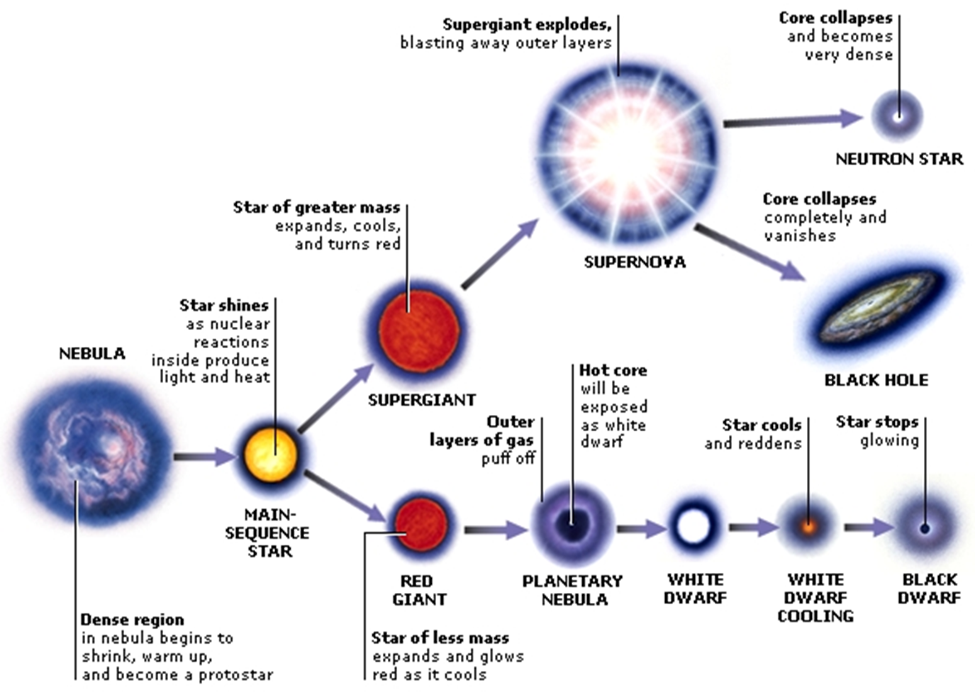

Slide 21
How Stars Form
Stars formed when clouds of hydrogen atoms were brought together by gravity.
As the clouds became increasingly dense, temperature and pressure rose dramatically and the hydrogen atoms at the center of each cloud began to fuse into helium atoms.
This process, called fusion, released tremendous amounts of energy and balanced the pull of gravity, which was trying to fuse the core of each cloud into an even denser mass.
As the two forces (gravity and fusion) reached a balance in each cloud, a star was born.
When a number of stars had been born, the force of gravity began attracting stars into groupings called galaxies. Gravity also grouped galaxies into clusters and clusters into superclusters

Slide 22
New Elements Form from Dying Stars
How a star lives and dies is determined in large part by its size. Bigger, denser stars burn hotter and run out of fuel more quickly than small or medium stars. Star death can create the temperatures and pressures necessary for star formation.
The ingredients necessary for the formation of the chemical elements are very high temperatures and aging and dying stars.
The Goldilocks Conditions necessary for the formation of new chemical elements are stars running out of their fuel and giant stars collapsing.
The death of medium- and large-sized stars can generate temperatures and pressure high enough to create all the elements up through iron.
The death of very large-sized stars can generate temperatures and pressure high enough to create all the elements up through uranium.
The most massive stars die in supernova explosions, which are the biggest most spectacular explosions in the Universe. A supernova can shine with the brightness of an entire galaxy.

Slide 23
New Elements Form From Dying Stars
Hydrogen and helium formed in the early moments after the Big Bang. They are the simplest naturally occurring elements and were formed in great quantities as the early Universe cooled.
Much higher temperatures and pressures are required to create bigger, more complex elements. Dying stars are the one place that provide the right conditions.
When large stars die, they can achieve temperatures of 3 billion degrees, which is hot enough to create iron atoms through fusion. The death of large stars can produce numerous heavy elements.
The supernova death of a high-mass star generates many of the heavy elements in the periodic table and disperses them into space.
The formation of new chemical elements was only possible through the death of stars, and the creation of these elements made a more complex Universe possible.

