Slide 1
Astronomy-Part 6 Notes: Historical Models of the Solar System

Slide 2
What is the center of the Solar System?
The solar system is the sun and all of the bodies that orbit the sun.
Our current model of the solar system is the sun-centered, or heliocentric, model.
In the heliocentric model, Earth and the other planets orbit the sun.

Slide 3
What is the center of the Solar System?
The earliest models of the solar system assumed that Earth was at the center, with the sun, moon, and planets circling it.
These models, which used Earth as the center, are called Earth-centered, or geocentric, models.
The heliocentric model was not generally accepted until the work of Copernicus and Kepler in the late 16th to early 17th centuries.

Slide 4
Early Models of the Solar System
Until Galileo improved on the telescope in 1609, people observed the heavens with the unaided eye.
To observers, it appeared that the sun, the moon, the planets, and the stars moved around Earth each day.
This caused them to conclude that Earth was not moving but was at the center of the solar system, with all other bodies revolving around it.
Notes:
4

Slide 5
The geocentric model of the solar system became part of ancient Greek thought beginning in the sixth century B.C.E.
The Greek philosopher Aristotle (384–322 B.C.E.) was among the first thinkers to propose this model.
His model placed the moon, sun, planets, and stars on a series of circles that surrounded Earth.
Notes:
5

Slide 6
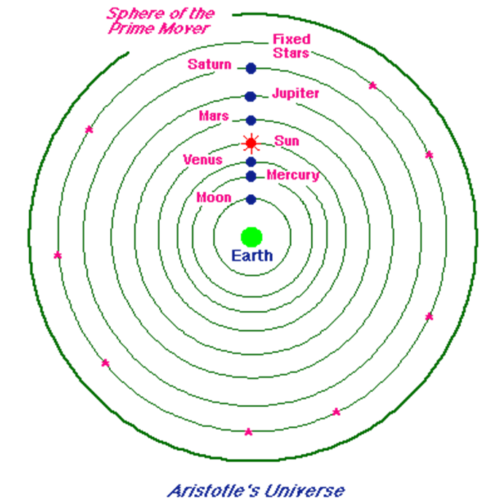
The Geocentric Model

Slide 7
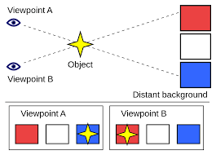
Aristotle thought that if Earth went around the sun, then the relative positions of the stars would change as Earth moves.
This apparent shift in the position of an object when viewed from different locations is known as parallax.
In fact, the stars are so far away that parallax cannot be seen with the unaided eye.
Notes:
7

Slide 8
Early Models of the Solar System
Aristarchus, a Greek astronomer and mathematician, is reported to have proposed a heliocentric model of the solar system.
His model, however, was not widely accepted at the time.
His attempts to measure the relative distances to the moon and the sun became a major contribution to science.
Notes:
8

Slide 9
Ptolemy was an astronomer, geographer, and mathematician who lived in Alexandria, Egypt.
His book, the Almagest, was based on observations of the planets going back as far as 800 years.
He developed a detailed geocentric model that was used by astronomers for the next 14 centuries.
Notes:
9

Slide 10
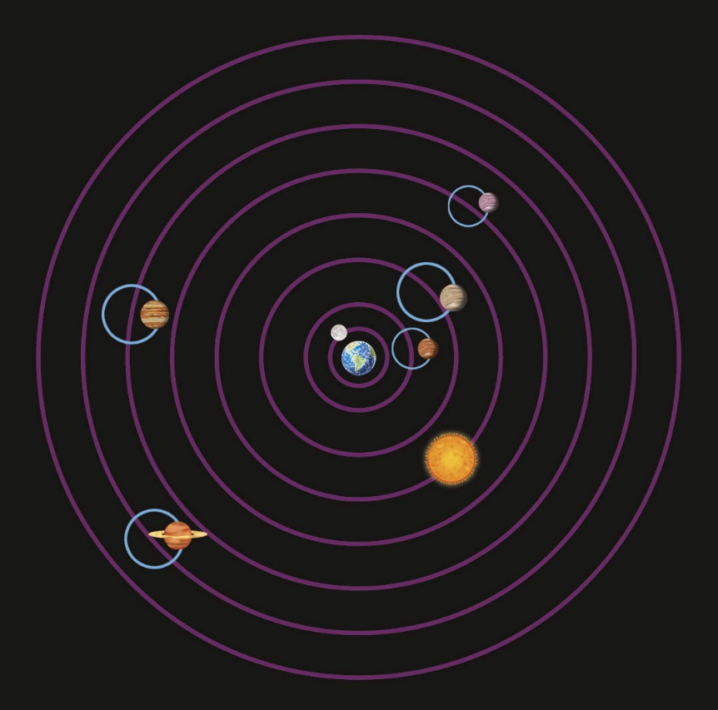
In Ptolemy’s model, the planets moved on small circles that in turn moved on larger circles.
Notes:
10

Slide 11
Ptolemy’s “wheels-on-wheels” system fit observations better than any model that had come before.
Ptolemy’s model allowed people to predict the motions of planets years into the future.
Notes:
11

Slide 12
The Polish astronomer Nicolaus Copernicus felt that Ptolemy’s model of the solar system was too complicated.
He knew about Aristarchus’s ideas when he developed the first detailed heliocentric model of the solar system.
Copernicus adopted Ptolemy’s idea that planetary paths should be perfect circles.
Notes:
12

Slide 13
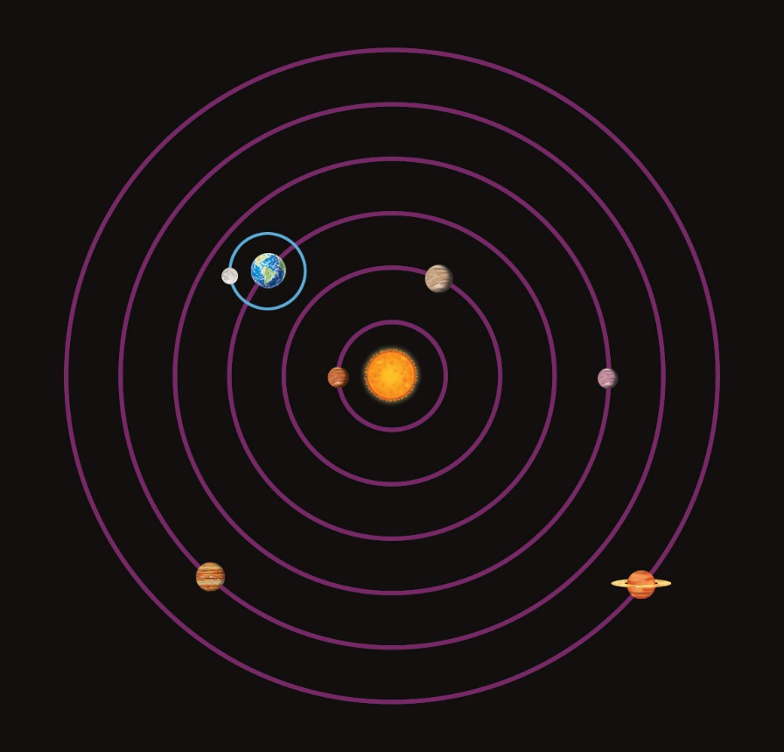
Like Ptolemy, Copernicus used a “wheels-on-wheels” model.
Notes:
13

Slide 14
Copernicus’s model fit observations a little better than Ptolemy’s geocentric model.
Copernicus’s model is generally seen as the first step in the development of modern models of the solar system.
Notes:
14

Slide 15
Johannes Kepler was a German mathematician and astronomer.
After careful observation and analysis, he realized that planetary orbits were not circular but were more like ellipses.
He formulated three principles, which are today known as Kepler’s laws.
Notes:
15

Slide 16
Kepler’s Laws
Kepler’s first law states that planetary orbits are ellipses with the sun at one focus.
The second law states that planets move faster in their orbits when they are closer to the sun.
The third law relates the distance of a planet from the sun to the time the planet takes to go once around its orbit.
Notes:
16

Slide 17
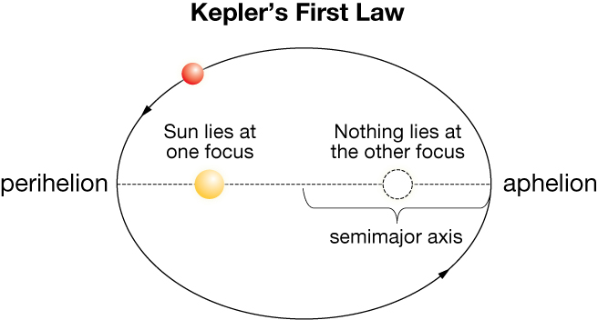
Copyright © Houghton Mifflin Harcourt Publishing Company
Notes:
17

Slide 18
Galileo
Galileo Galilei was a scientist who approached questions in the fashion that today we call scientific methods.
He significantly improved the newly invented telescope and used it to view celestial objects.
He observed the moons Io, Europa, Callisto, and Ganymede orbiting Jupiter. Today, these moons are known as the Galilean satellites.
Notes:
18

Slide 19
Galileo’s observations showed that Earth was not the only object that could be orbited.
This gave support to the heliocentric model.
Galileo also observed that Venus went through phases similar to the phases of Earth’s moon.
These phases result from changes in the direction that sunlight strikes Venus as Venus orbits the sun.
Notes:
19

Slide 20
Galileo demonstrated that all bodies, regardless of their mass, fall at the same speed.
He also argued that moving objects retain their velocity unless a force acts upon them.
Notes:
20

