Slide 1
Astronomy-Part 1 Notes The Structure of the Universe

Slide 2
What IS the Universe?
The universe is space and all the matter and energy in it.

Slide 3
What makes up the Universe?
Stars and planets
Gas and dust
Organized into star clusters
Organized into nebulae
Organized into galaxies
Other things:
Black holes
Dark matter
Dark energy

Slide 4
Our Place In Space.
Earth is one of eight planets that orbit the sun, which is a star.
A star is a large celestial body that is composed of gas and emits light. Stars are grouped together in structures known as galaxies.
A galaxy is a large collection of stars, gas, and dust.
There are an estimated 100 billion galaxies in the universe.
Made of billions to trillions of stars
Also may have gas and dust

Slide 5
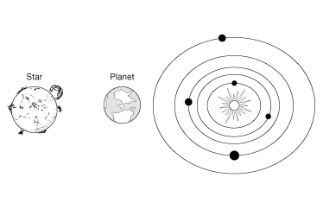
What Makes Up The Universe?
The solar system is the collection of large and small bodies that orbit our central star, the sun.
The solar system has eight bodies called planets, which are generally larger than the other bodies.
A planet is a spherical body that orbits the sun.

Slide 6
What Makes Up The Universe?
The four planets that orbit nearest to the sun are called terrestrial planets.
The terrestrial planets are Mercury, Venus, Earth, and Mars.
The terrestrial planets are rocky, dense, and relatively small.

Slide 7
What Makes Up The Universe?
Earth is a special place because it has just the right combination of conditions to support life.
The presence of air and water supports the growth and development of plants and animals.
The atmosphere contains an ozone layer that absorbs harmful solar radiation and other gases that keep Earth warm enough for life to exist.

Slide 8
What Makes Up The Universe?
The four planets that orbit farthest from the sun are called gas giant planets.
The gas giant planets are Jupiter, Saturn, Uranus, and Neptune.
The gas giant planets have thick, gaseous atmospheres; small, rocky cores; and ring systems of ice, rock, and dust.

Slide 9
What Makes Up The Universe?
Orbiting most of the planets are smaller bodies called moons. Earth has only one moon, but Jupiter has more than 60.
The solar system has other small bodies, including dwarf planets, comets, asteroids, and meteoroids.
Altogether, there are up to a trillion small bodies in the solar system.

Slide 10
What Makes Up The Universe?
A star is a large celestial body that is composed of gas and emits light.
Most stars are composed almost entirely of hydrogen and helium.

Slide 11
Types of Stars
Big
Small
Red
Blue
Yellow
In groups
Alone
More later

Slide 12
What Makes Up The Universe?
Energy is produced in the core of the star by the process of nuclear fusion.
Energy escapes in the form of light, other forms of radiation, heat, and wind.
Stars range in size from about the size of Earth to as much as 1,000 times the size of the sun.

Slide 13
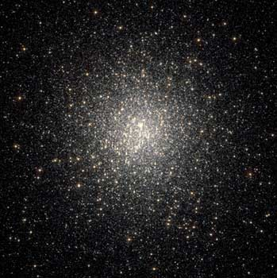
What are star clusters?
Stars formed together at same time.
Stars may be gravitationally bound together.
Two types: open (galactic) and globular

Slide 14
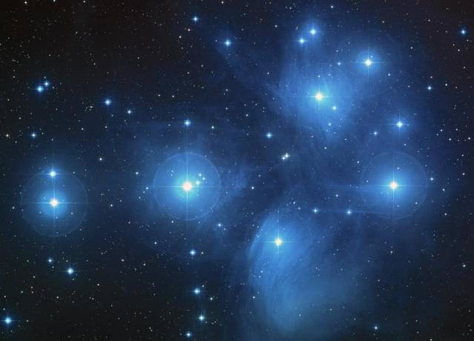
Open Clusters
Dozens to thousands of stars
Young stars! only a few million years old
May still be surrounded by nebula from which they formed.
Located in the spiral arms of a galaxy
Example: Pleiades

Slide 15
Globular Clusters
Millions to hundreds of millions of stars
Old! 6 to 13 billion years
Mostly red giants and dwarfs
Stars are clumped closely together, especially near the center of the cluster (densely)
Surround our disk as a halo

Slide 16
What Makes Up The Universe?
A galaxy is a large collection of stars, gas, and dust held together by gravity.
Small galaxies, called dwarf galaxies, may contain a few billion stars. Giant galaxies may contain hundreds of billions of stars.
Our solar system is located in the Milky Way galaxy. The Milky Way is classified as a spiral galaxy.

Slide 17
Mapping the Milky Way
How do we know what our galaxy looks like?
We can see stars:
star clusters
nebulae
Galaxies

Slide 18
What Makes Up The Universe?
Spiral galaxies are shaped like pinwheels. They have a central bulge from which two or more spiral arms extend.
Elliptical galaxies look like spheres or ovals and do not have spiral arms.
Irregular galaxies appear as splotchy, irregularly shaped “blobs.” They are very active areas of star formation.

Slide 19
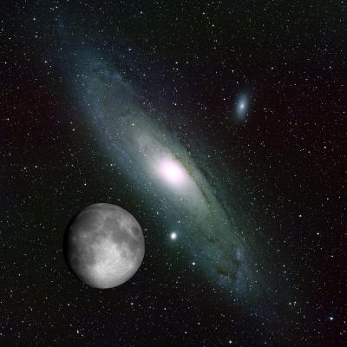
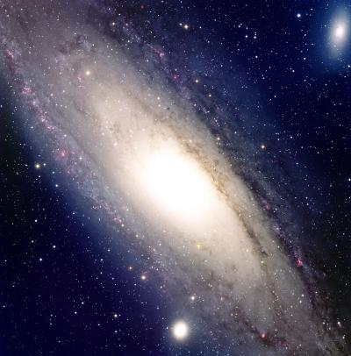
Spiral Galaxy
Andromeda

Slide 20
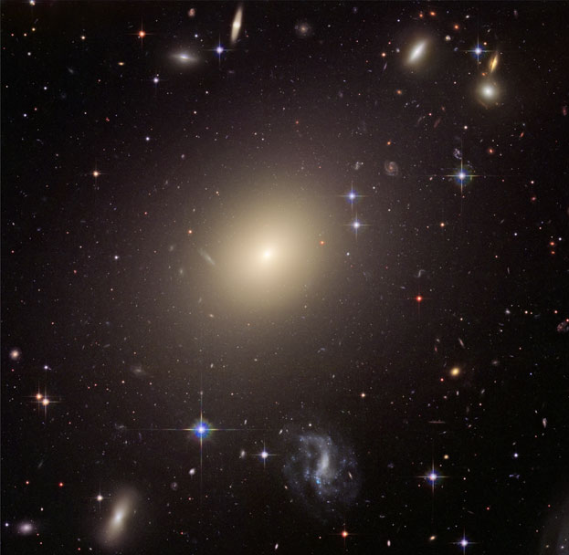
Elliptical Galaxy

Slide 21
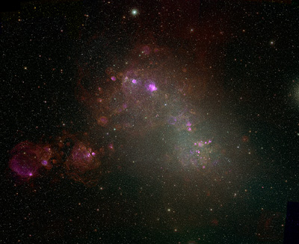
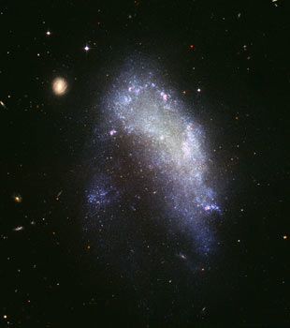
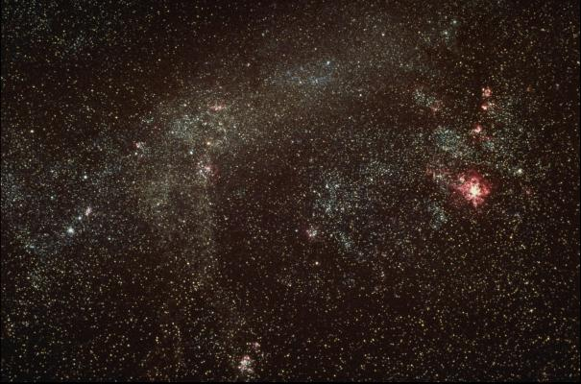
Irregular Galaxy

Slide 22
Our Galaxy-The Milky Way
Has about 200 billion stars, and lots of gas and dust
Is a barred-spiral (we think)
About 100,000 light-years wide
Our Sun is halfway to the edge, revolving at half a million miles per hour around the center of the Galaxy
Takes our Solar System about 200 million years to revolve once around our galaxy

Slide 23
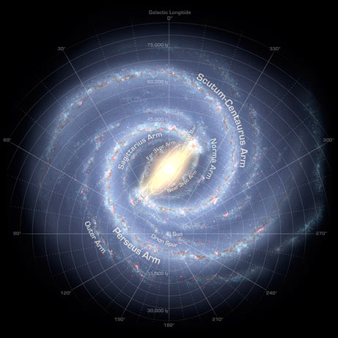

Slide 24
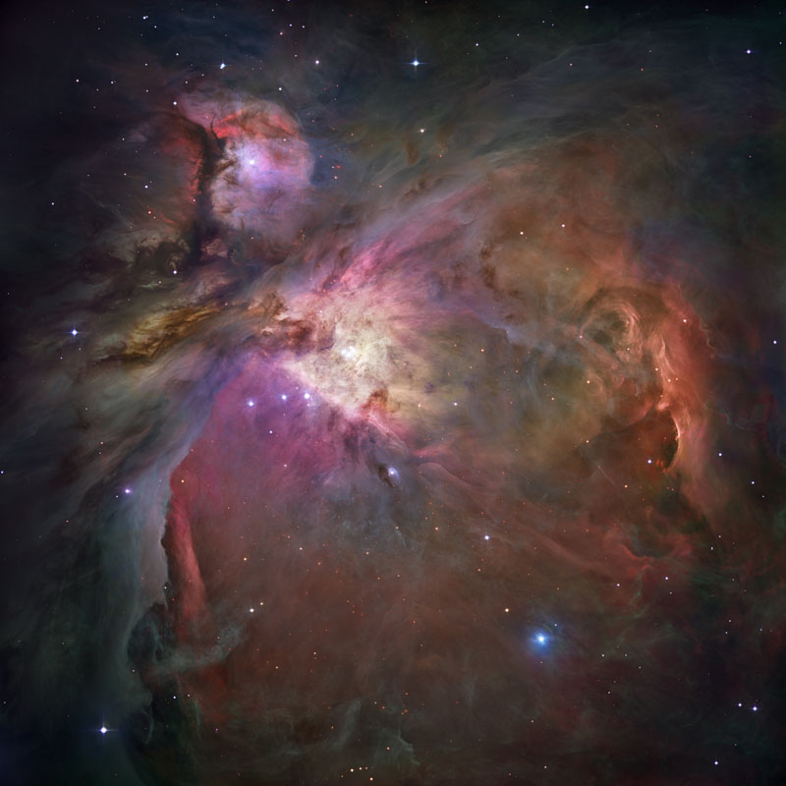
What is a “nebula”?
A cloud in space
Made of gas and dust
Can have stars inside
Most of the ones we see are inside our Milky Way Galaxy
Different types.

Slide 25
Large, Massive, Bright
Emission Nebula
The Hot Gas is emitting light.

Slide 26
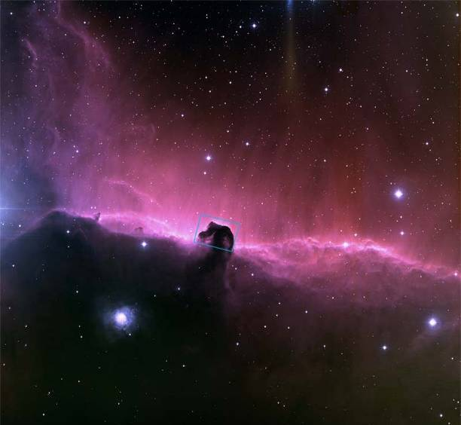
Colder, Darker Nebula
Dark dust is blocking the gas behind it.

Slide 27
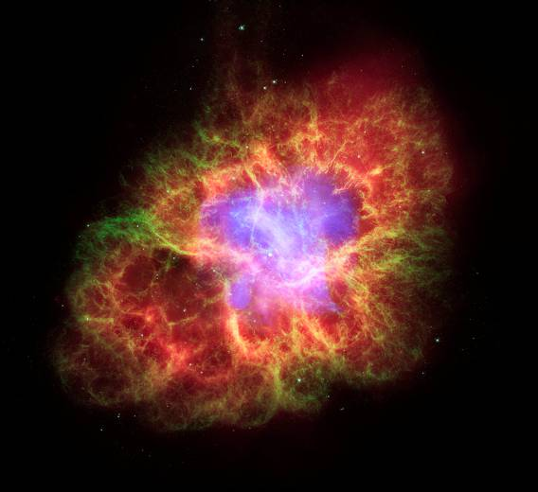
Leftovers from an explosion.
Supernova remnant
smaller, less gas.

Slide 28
How BIG is BIG?
Distances between most objects in the universe are so large that astronomers measure distances using the speed of light.
A light-year is the distance that light travels through space in one year.
Light travels through space at about 300,000 km/s, or about 9.5 trillion kilometers in one year.

Slide 29
How BIG is BIG?
Throughout the universe, there are areas where galaxies are densely concentrated.
These areas are called clusters and superclusters.
Clusters contain as many as several thousand galaxies.
Superclusters can be made up of 10 or more clusters of galaxies.
The universe also contains huge spherical areas where very little matter exists. These areas are called voids.

Slide 30
How BIG is BIG?
Astronomers have begun to think of the universe as having a structure similar to soap bubbles.
Clusters and superclusters are located along the thin bubble walls.
The interior of the bubbles are voids. It takes light hundreds of millions of years to cross the largest voids.

