Slide 1
Astronomy-Part 9 Notes The Planets and Small Bodies

Slide 2
The Terrestrial Planets
The terrestrial planets are the four small, dense, rocky planets that orbit closest to the sun.
In order by distance from the sun, these planets are Mercury, Venus, Earth, and Mars.
The terrestrial planets have similar compositions and consist of an outer crust, a central core, and a mantle that lies between the crust and core.

Slide 3
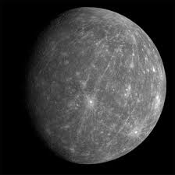
Mercury
Mercury has a heavily cratered, moonlike surface, composed mainly of volcanic rock. It has a massive iron core.
Mercury orbits the sun at a distance of 0.39 astronomical units (AU).
One astronomical unit is the average distance between the sun and Earth, or approximately 150 million km.
On Mercury, a day lasts almost 59 Earth days.
The daytime temperature can rise to 427 °C, and the nighttime temperature can drop to –184 °C.
Mercury is the smallest planet in the solar system, with an equatorial diameter of 4,879 km.
Mercury’s core makes up most of its volume. Its core is thought to be partly molten.

Slide 4
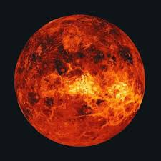
Venus
Venus’s diameter is 95 percent of Earth’s diameter, and its mass is about 80 percent of Earth’s.
Because they are so similar in size, Venus is sometimes called “Earth’s twin.” However, there are many differences between the two planets.
Earth has prograde rotation, which means that it rotates counterclockwise about its axis as seen from above its north pole.
Venus has retrograde rotation, which means that it rotates clockwise about its axis as seen from above its north pole.

Slide 5
Venus
It takes more time for Venus to rotate once about its axis than it takes for the planet to revolve once around the sun.
The surface of Venus is covered with thousands of volcanoes.
Venus’s surface also has craters.
The average surface temperature on Venus is 465 °C.
Carbon dioxide in the atmosphere traps the sun’s energy, causing surface temperatures to remain high.
Sulfuric acid rains down onto Venus’s surface, and the atmospheric pressure is at least 90 times that of Earth.

Slide 6
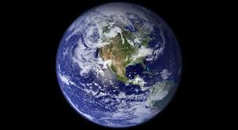
Earth
Earth is the only planet that can support life.
Earth has liquid water, an energy source, an atmosphere that contains oxygen, and a number of ecosystems for different organisms to inhabit.
Matter is continuously cycled between the environment and living things.
Earth’s oceans and moderate temperatures provided the ideal conditions for life to emerge and flourish.
It is thought that between 5 million and 30 million species of organisms currently inhabit Earth.

Slide 7
Earth
Earth is the only terrestrial planet whose surface is divided into tectonic plates.
Movement of these plates causes the continents to change positions over long periods of time.
Tectonic plate motion, together with weathering and erosion, has erased most surface features older than 500 million years.
The moon has a surface gravity that is only about one-sixth that of Earth.
The moon’s surface is heavily cratered.
The moon’s surface has large dark areas that are plains of solidified lava and light-colored areas that are highlands.

Slide 8
Earth
The moon rotates about its axis in the same time it orbits Earth. Therefore, it keeps the same side facing Earth.
The lunar day is a little more than 27 Earth days.
The moon’s surface temperature can reach 127 °C in the daytime, and it can fall to –173 °C at night.

Slide 9
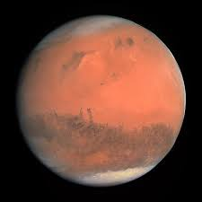
Mars
The northern hemisphere of Mars appears to have been covered by lava flows, and the southern hemisphere is heavily cratered.
Mars has large volcanoes and very deep valleys and canyons.
Mars has a very thin atmosphere, composed mostly of carbon dioxide.
During the Martian winter, carbon dioxide around the planet’s poles freezes into a thin coating. This coating vanishes during the summer.
Winds on Mars cause giant dust storms.
A number of features on Mars provide evidence that liquid water once flowed on the planet’s surface and may be found beneath the surface.

Slide 10
Mars
The Mars Exploration Rovers Spirit and Opportunity have been exploring Mars since they landed there in January 2004.
They are searching for evidence indicating that water once flowed on the Martian surface and for environments in which life may have existed.
The surface of Mars is made up mostly of the volcanic rock basalt, which is also found on Earth.

Slide 11
Gas Giants
Jupiter, Saturn, Uranus, and Neptune are the gas giant planets.
Gas giants have deep, massive gas atmospheres, which are made up mostly of hydrogen and helium. They have no surface to stand on.
The gas giant planets are large and cold.

Slide 12
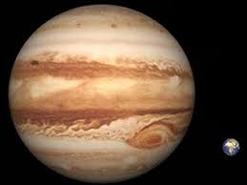
Jupiter
Jupiter is the largest planet in the solar system.
Jupiter’s mass is twice that of the other seven planets combined. It has the highest surface gravity in the solar system.
Although all of the gas giant planets rotate rapidly, Jupiter rotates fastest of all. Its period of rotation is just under 10 hours.
The winds on Jupiter can be as fast as 540 km/h.
Clouds are stretched into bands that run from east to west.
Storms appear as white or red spots between cloud bands. The best known of these storms is the Great Red Spot.

Slide 13
Jupiter
More than 60 moons orbit Jupiter.
Io, Europa, Callisto, and Ganymede are the largest moons of Jupiter.
Io is the most volcanically active place in the solar system. It has at least 400 active volcanoes, ejecting lava and geysers of sulfur compounds.
Europa has an icy surface.
Recent evidence suggests that an ocean of liquid water may lie beneath Europa’s surface.

Slide 14
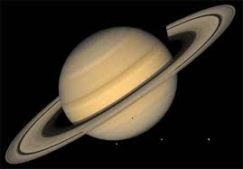
Saturn
Saturn is the second-largest gas giant planet. It is made mostly of hydrogen and helium.
Saturn’s average density is less than that of water.
Saturn’s most spectacular feature is a planetary ring system that circles the planet’s equator.
A planetary ring system is a disk of material that circles a planet and consists of orbiting particles.
Saturn’s ring system has many individual rings that form complex bands. Between bands are gaps that may be occupied by moons.

Slide 15
Saturn
Saturn’s rings are nearly 500,000 km in diameter, but they are only a few kilometers thick.
The rings are mostly pieces left over from the collision of Saturn’s moons with comets and asteroids.
Saturn’s moon Enceladus has an icy surface. Liquid water flows up through cracks in the surface and freezes or forms spectacular geysers.
Titan, Saturn’s largest moon, has an atmosphere composed mostly of nitrogen, with traces of methane and ethane.
Titan has a crust of ice, with lakes and ponds filled mostly with liquid methane.

Slide 16
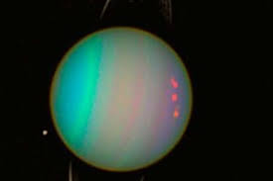
Uranus
The atmosphere of Uranus is composed mostly of hydrogen and helium. It also contains methane.
The methane absorbs red light, which gives the planet a blue-green color.
Uranus’s axis of rotation is tilted almost 98°, which means that the planet is tilted on its side as it orbits the sun.
Uranus has 27 moons and a ring system, all of which orbit the planet’s equator.
It takes Uranus 84 years to make a single revolution around the sun.

Slide 17
Uranus
For 21 years, the north pole faces the sun and the south pole is in darkness.
After another 21 years, the poles are reversed. The south pole faces the sun and the north pole is in darkness for 21 years.
Every place on Uranus has winter periods of constant darkness and summer periods of constant daylight.
During spring and fall, Uranus has periods of both daytime and nighttime, just like on Earth.
Miranda is Uranus’s fifth-largest moon. It is covered by different types of icy crust.
The gravitational forces of Uranus pull on Miranda’s interior, causing material from the moon’s interior to rise to its surface.

Slide 18
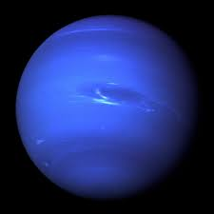
Neptune
Neptune is the most distant planet from the sun.
Sunlight on Neptune is 900 times fainter than sunlight on Earth.
High noon on Neptune may look like twilight on Earth.
Neptune is almost the same size as Uranus.
Like Uranus, Neptune has an atmosphere composed of hydrogen and helium, with some methane.
Neptune’s bluish color is caused by the absorption of red light by methane.

Slide 19
Neptune
In 1989, Voyager 2 revealed a huge dark area in Neptune’s atmosphere. This storm was named the Great Dark Spot.
In 1994, the Hubble Space Telescope found no trace of this storm, but other spots that may grow larger with time have been sighted.
The energy that powers the strong winds in such storms may come from Neptune’s warm interior.
Triton is the largest moon of Neptune.
Unlike the other moons, Triton orbits Neptune in the opposite direction from the direction in which Neptune orbits the sun.
Triton is slowly spiraling inward toward Neptune. It is expected that the planet’s gravitational pull will eventually begin pulling Triton apart.

