Slide 1
Number Systems-Part 6

Slide 2
What is Scientific Notation?
Often, Scientists need to express small measurements, such as the mass of a proton at the center of a hydrogen atom (0.000000000000000000000000001673 kg), and large measurements, such as the temperature at the center of the Sun (15000000 K). To do this conveniently, they express the numerical values of small and large measurements in scientific notation.

Slide 3
Breaking it Down
Scientific Notation has two parts:
In this setup, 1≤N<10, meaning that N can be any number from 1 to a number less than 10.

Slide 4
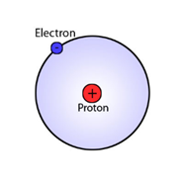
Examples
Thus, the temperature of the sun, 15 million kelvins, is written as ______________________K in scientific notation.
What is the mass of a proton at the center of a hydrogen atom written in scientific notation?

Slide 5
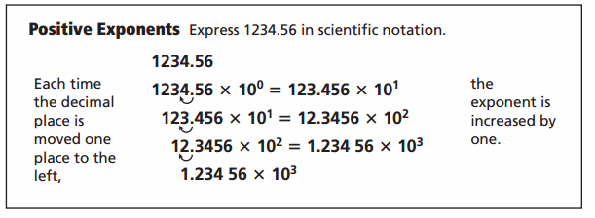
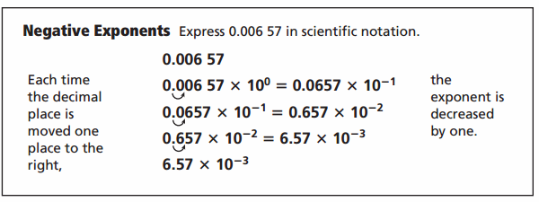
Positive vs Negative Exponents
Examples: Write in Scientific Notation:
The radius of an argon atom, 0.000000000098 m.
The speed of light in a vacuum, 299792458 m/s

Slide 6
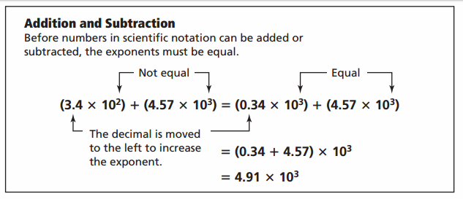
Operations in Scientific Notation

Slide 7
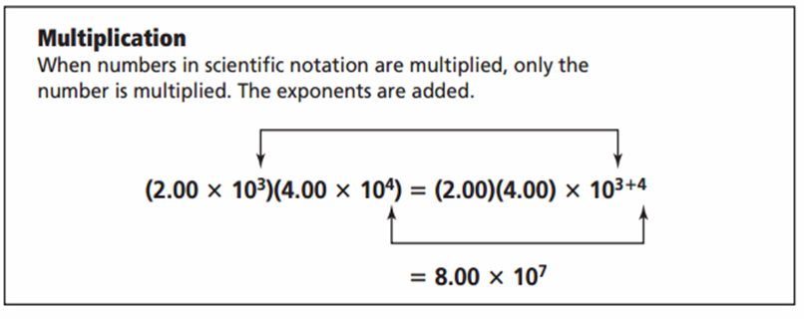
Operations in Scientific Notation

Slide 8
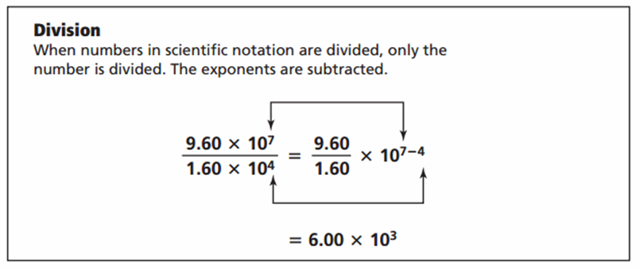
Operations in Scientific Notation

